Slide 1
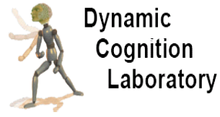
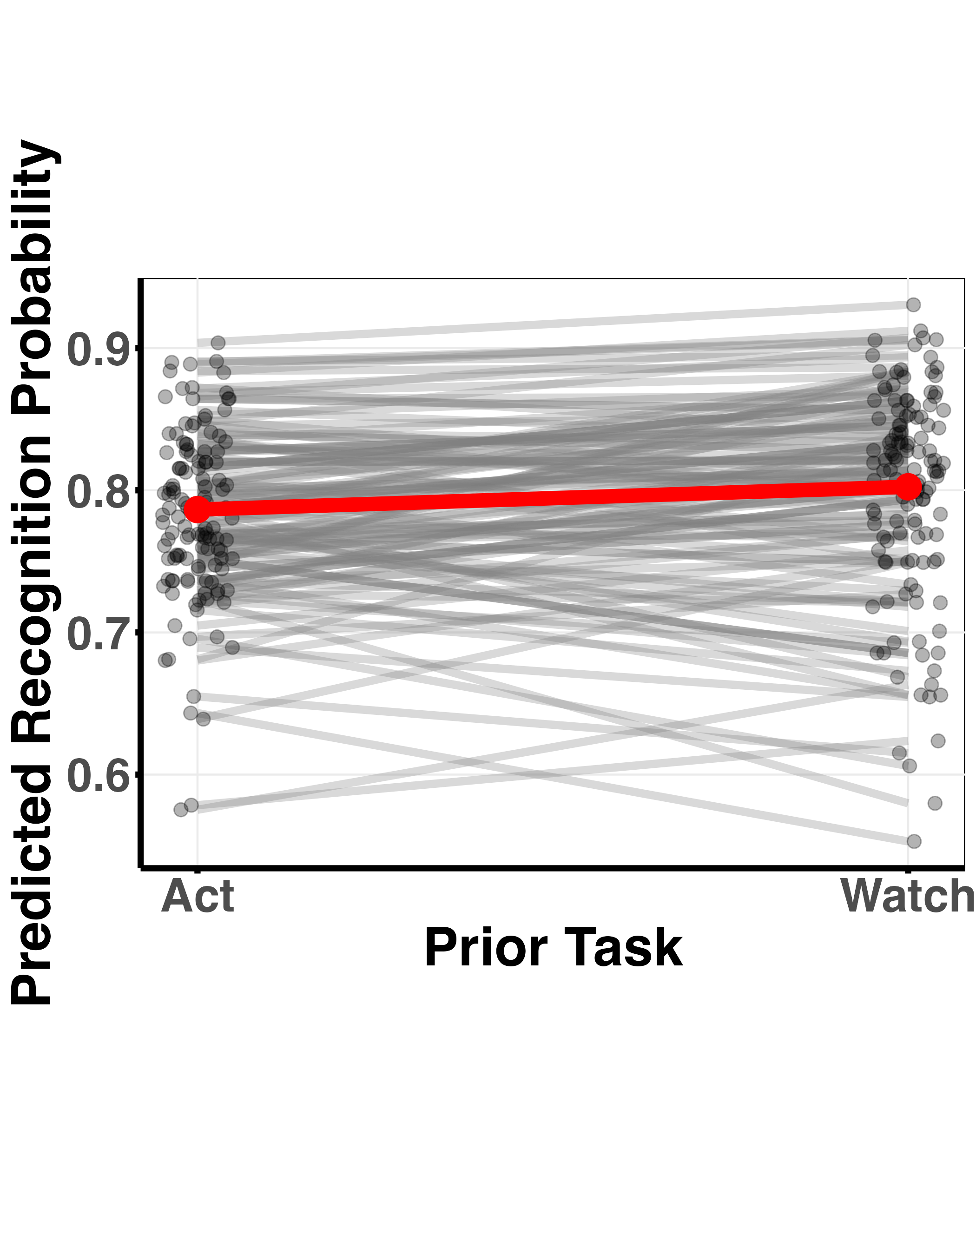
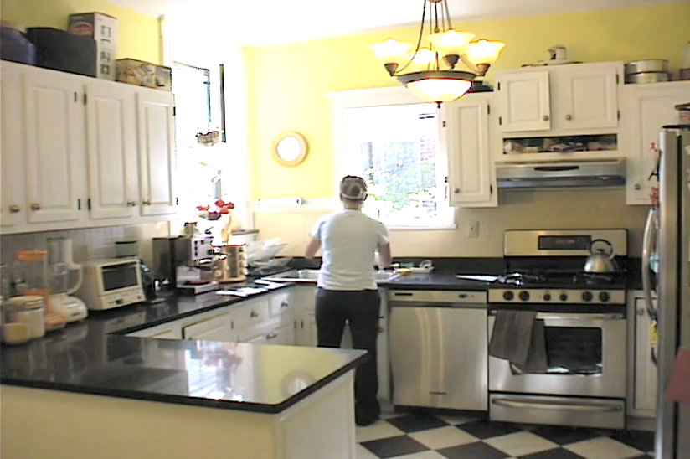
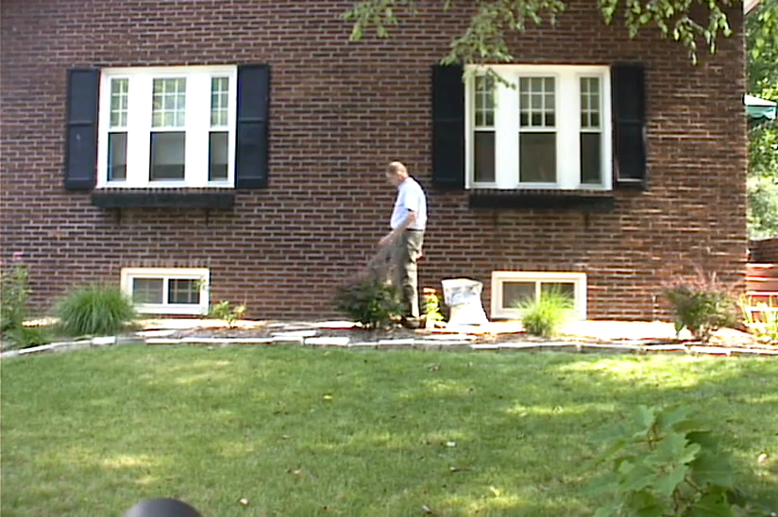
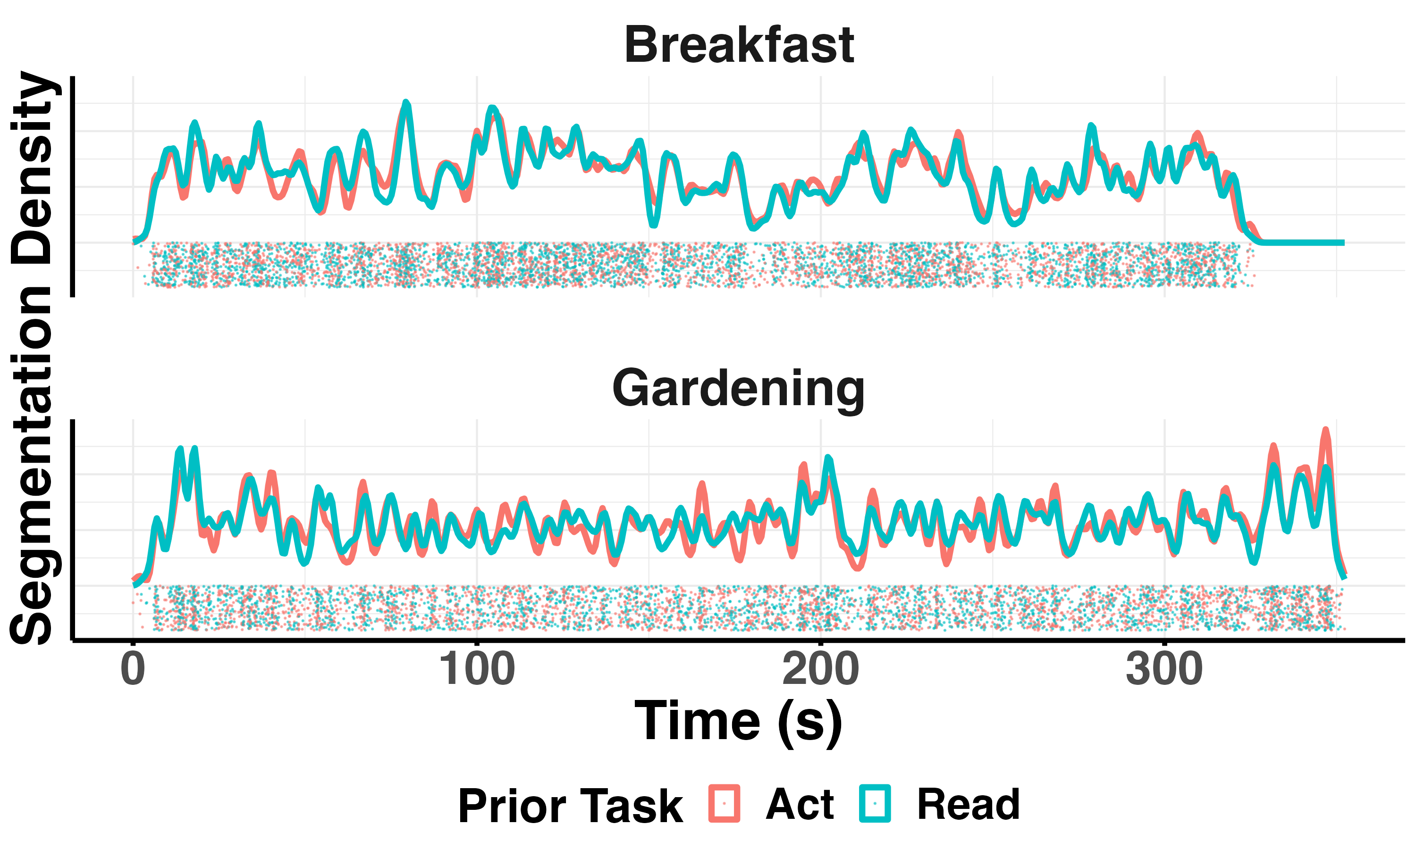
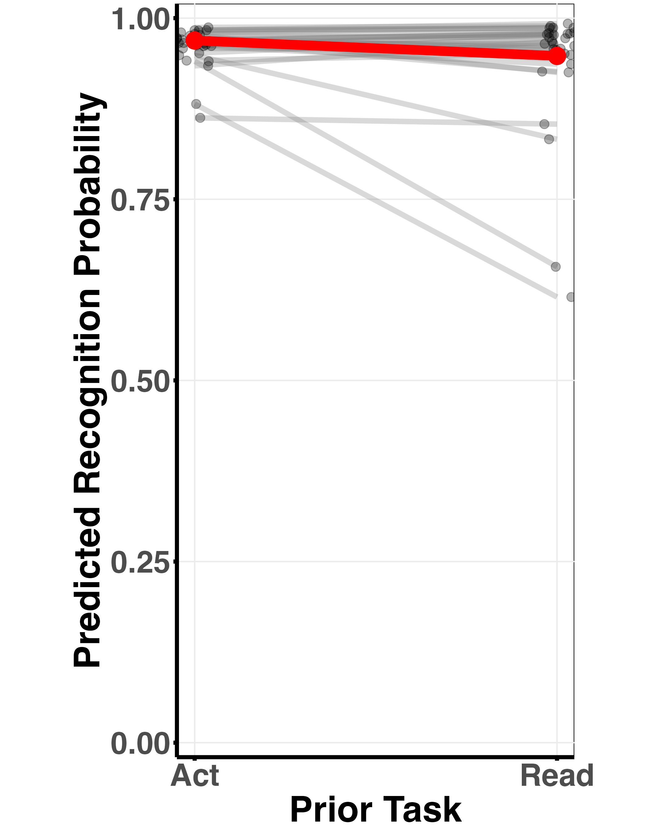
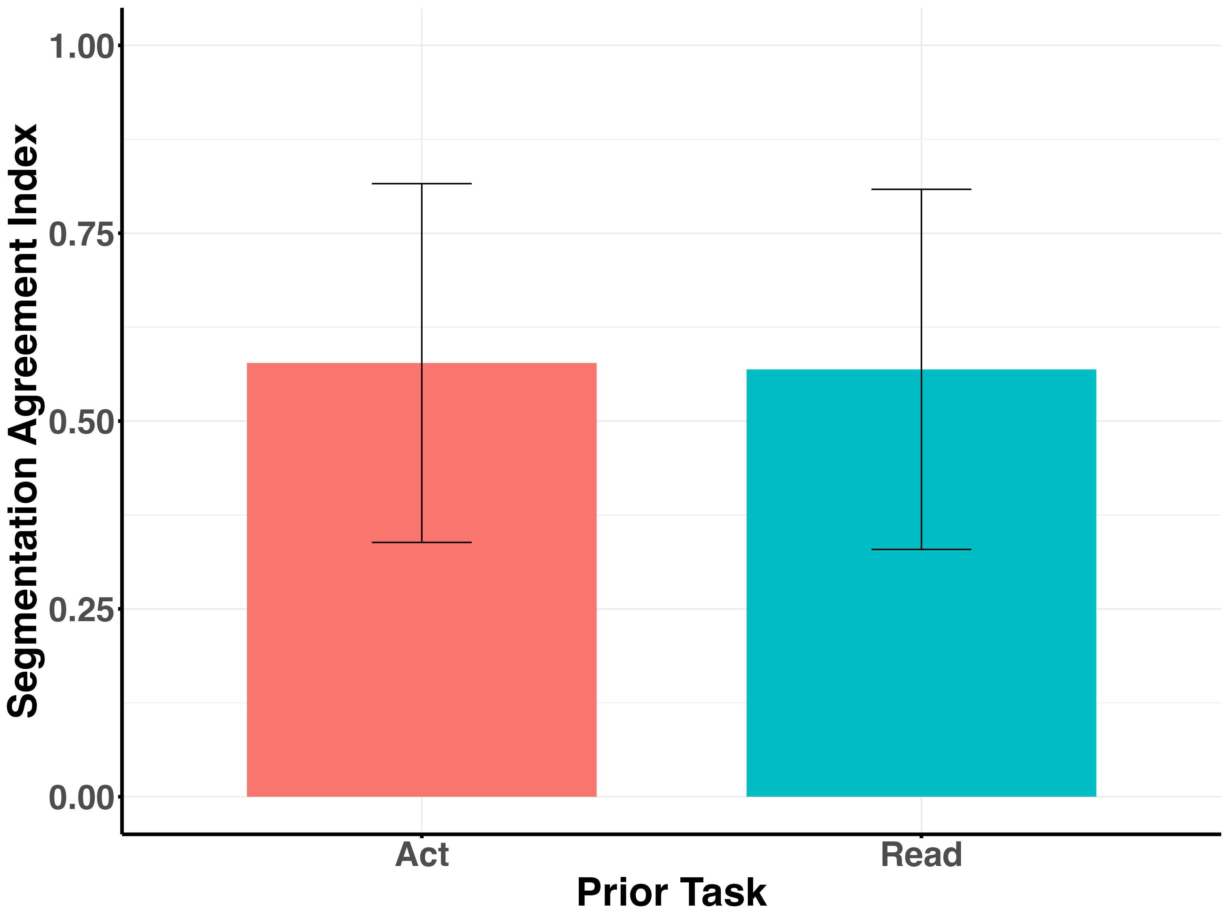
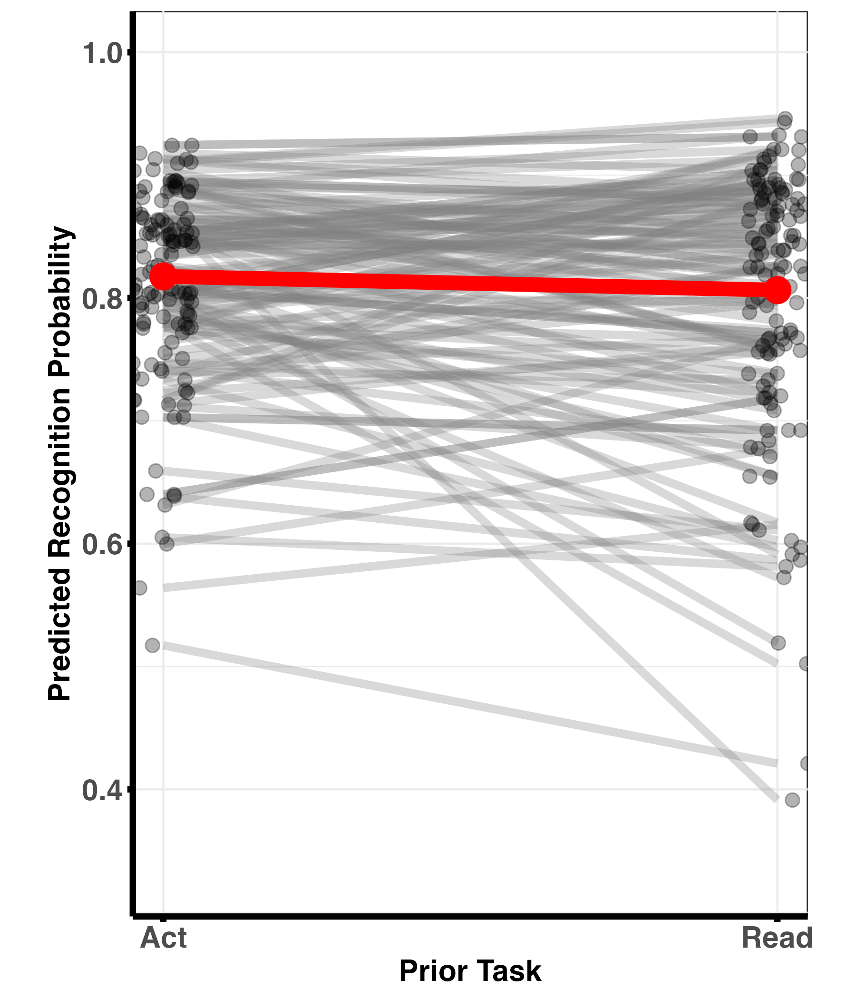
Action Enhances Memory of Descriptions but Not Memory or Segmentation of Movies
Sophie (Xing) Su, Jeremy R. Cohn, Jeffrey M. Zacks
Department of Psychological & Brain Sciences, Washington University in St. Louis
Background
The Impact of Acting on Episodic Memory of Everyday Activities
Embodied cognition theory: Shared neural mechanisms for acting, perceiving, and remembering actions¹.
Enactment effect: Performing actions enhances memory for their descriptions².
In perception, previous studies have shown a positive correlation between action performance and perceiving structures in everyday activities, as measured by event segmentation task³.
Yet, embodied cognition suggests detailed action simulation might negate physical performance effects on memory and perception.
We conducted four studies testing embodied cognition's claims about action's influence on perception and memory of everyday activities.
Participants: N=129, Female= 76, Male=69, Mean Age:28.69, SD:5.55
Task:
For one movie, the participants simply watched, while for the other, they mimicked the actions during viewing. They were subsequently tested on their recognition memory of the movie content.
The order of the movies and tasks was counterbalanced across participants.
Hypotheses
Copying
Breakfast Action
While Watching
Breakfast
Movie
Recognition
Watch Gardening Movie
Gardening
Movie
Recognition
Extending the enactment effect to everyday activities, action performance will enhance both memory and structural perception.
Action Simulation Account: Visual-spatial cues may activate motor representations regardless of actual performance, negating prior action effects.
Bayes factor is 0.02, suggesting that there is strong evidence for the null.
The Impact of Acting on Event Segmentation of Everyday Activities
Enactment Effect for Action Embedded in Daily Activities
Participants: N=127, Female=60, Male=50, Mean Age:27.73 SD:5.66
Task:
Participants read and acted out a series of actions in the order shown in the movies. They then performed the segmentation task on the corresponding movies
The order of the movies and tasks was counterbalanced across participants.
Stimuli:
225 Action descriptions from two movies (breakfast and gardening)
Participants:
N=33, Female=15, Male= 18, Mean Age:36.07, SD:11.74
Task:
Participants read and enacted action sequences as shown in movies, then completed a recognition test (selecting one correct action description from three options)
The order of the movies and tasks was counterbalanced across participants
Act out
Breakfast Descriptions
Segment
Breakfast Movie
Read
Gardening Descriptions
Segment
Gardening Movie
Act out
Breakfast Descriptions
Breakfast Descriptions
Recognition
Read Gardening Descriptions
Gardening Descriptions
Recognition
Segmentation Agreement Index: scaled correlation between an individual's segmentation pattern and the group-averaged segmentation pattern
Controlling for the random effects of participants and movie type, the probability of recognizing the action descriptions was significantly higher after acting out these actions compared to reading them (p=0.003).
No Enactment Effect for Recognition Memory of Movies
Bayes Factor is 0.21 , suggesting that there is moderate evidence to support the null.
Participants: N=130, Female=74, Male=56, Mean Age:28.16, SD:4.61
Task:
Participants enacted action sequences, watched corresponding movies, then completed a two-option recognition test on movie content. The order of the movies and tasks was counterbalanced across participants.
Conclusions & Key Takeaways
We replicated the enactment effect for action descriptions embedded in everyday activities. However, this effect did not generalize to the perception or recognition of everyday activities in continuous visual-audio format. Consistent with embodied cognition, people simulate associated motor performance experiences while perceiving everyday activities in continuous visual-audio format. This study calls for caution when extending findings from lab-based studies of various memory techniques to real-life situations, where people have many cues to boost their memories, potentially rendering some explicit lab-developed strategies less effective.
Act out
Breakfast Descriptions
Watch
Breakfast Movie
Breakfast
Movie
Recognition
Read Gardening Descriptions
Watch Gardening Movie
Gardening
Movie
Recognition
Bayes factor is 0.02, suggesting that there is strong evidence for the null.
References
Acknowledgements
We thank the Dynamic Cognition Lab for their support and helpful discussion. We thank Ashwin Srinivasan and Vi Nguyen for data collection.
Barsalou, L. W. (2008). Grounded cognition. Annu. Rev. Psychol., 59(1), 617-645
Roberts, B. R., MacLeod, C. M., & Fernandes, M. A. (2022). The enactment effect: A systematic review and meta-analysis of behavioral, neuroimaging, and patient studies. Psychological bulletin, 148(5-6), 397.
Bailey, H. R., Kurby, C. A., Giovannetti, T., & Zacks, J. M. (2013). Action perception predicts action performance. Neuropsychologia, 51(11), 2294-2304.
Email: s.sophie@wustl.edu | Tweet at me: @sophiejoesu
Notes:
People look predictively throughout movies.
Predictive looking errors are positively and significantly correlated with segmentation probabilitie

